Slide 1
Question:
Consider a simple HMM POS tagger with only five tags (plus the beginning and end of sentence markers, <s> and </s>). The transition probabilities for this HMM are given by the table on the left below, where cell [i, j] is the probability of transitioning from state i to j (i.e., P(statej | statei)).
A subset of the output probabilities are given by the table on the right, where cell [i, j] is the probability of state i outputting word j (i.e., P(word j | state i)). We assume there are other possible output words not shown in the table, and that the <s> and </s> states output <s> and </s> words, respectively, with probability 1.

Slide 2
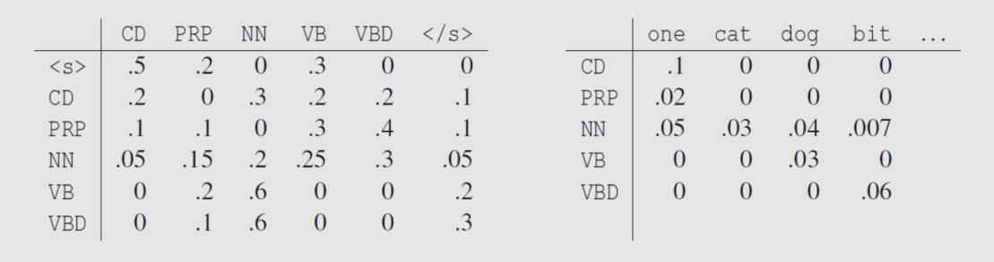

Slide 3
a) In the Penn Treebank tag scheme, what do the five different tags mean? Give example sentence.
b) Using the HMM probability matrices, compute P(w, q) (the joint probability of words and tags) for the sentence w = <s> one dog bit </s> with tags
q = <s> CD NN NN </s>.

Slide 4
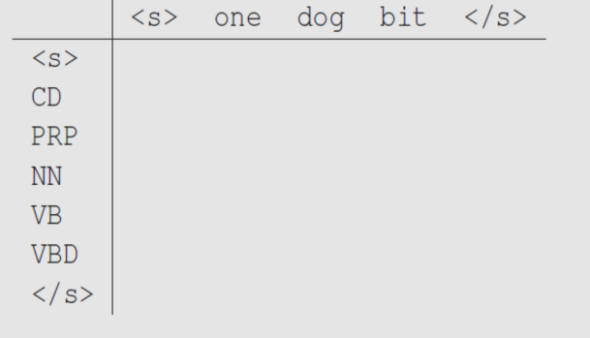
c) Using Viterbi algorithm, fill in the cells in the following table where cell [ j; t] should contain the Viterbi value for state j at time t. The rows of the table are already labeled with the different states, and the columns are already labeled with the observations at each time step.

Slide 5
Solution:
a) Cardinal number, personal pronoun, singular/mass noun, base verb, past tense verb.
Examples include:
One/CD person is here. One/PRP can see Arthur's Seat from here. The one/NN you are looking for is here.
I like the cat/NN.
The dog/NN is brown. His past mistakes dog/VB him to this day.
Give me a bit/NN of cake. The dog bit/VBD me.
b):
(0.5) × (0.3) × (0.2) × (0.05) × (0.1) × (0.04) × (0.007) = 4.2×10⁻⁻⁸.
(In an exam, it is not compulsory to complete the multiplication, only write down the terms.)

Slide 6
c)
 | <s> | one | dog | bit | </s>
<s> | 1 | 0 | 0 | 0 | 0
CD | 0 | 0.05 | 0 | 0 | 0
PRP | 0 | 0.004 | 0 | 0 | 0
NN | 0 | 0 | 6×10⁻⁴ | 1.26×10⁻⁶ | 0
VB | 0 | 0 | 3×10⁻⁴ | 0 | 0
VBD | 0 | 0 | 0 | 1.08×10⁻⁵ | 0
</s> | 0 | 0 | 0 | 0 | 3.24×10⁻⁶

